Slide 1


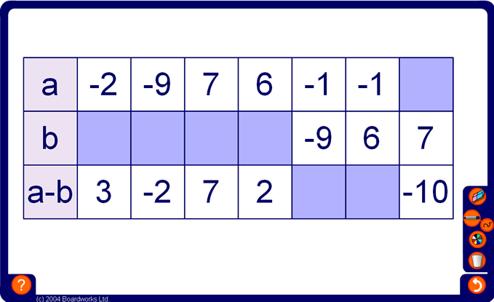


Complete this table
Notes:
This exercise may be completed orally as a class. Alternatively, give pupils a time limit to complete the task in writing before going through the answers.

